Slide 1
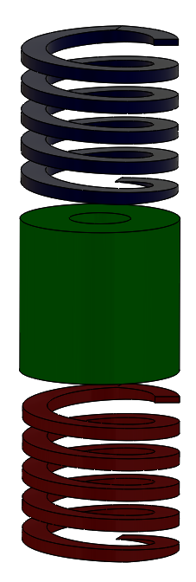
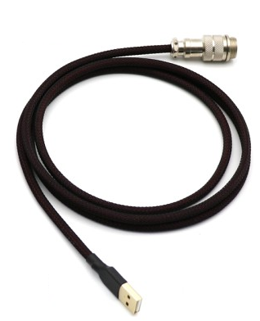

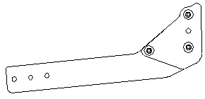
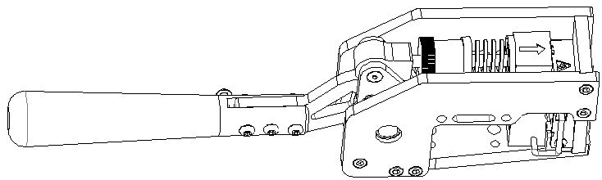
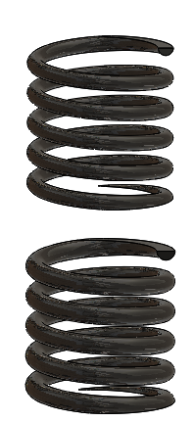
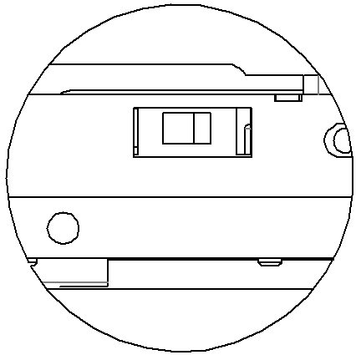
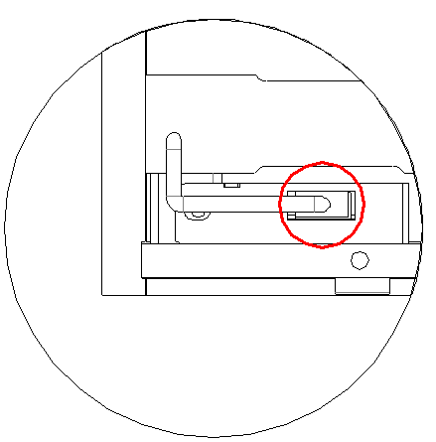
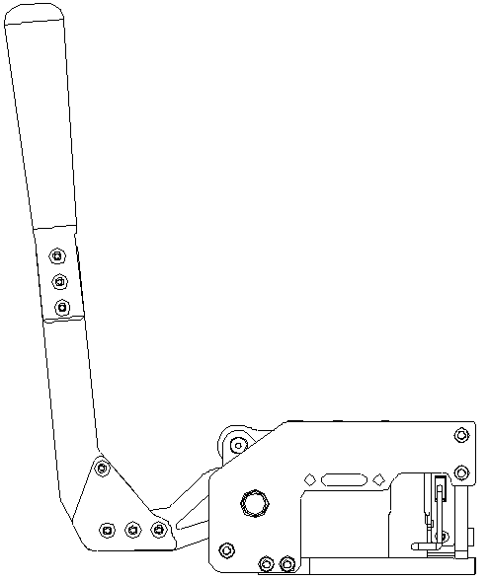

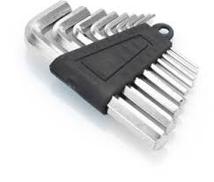
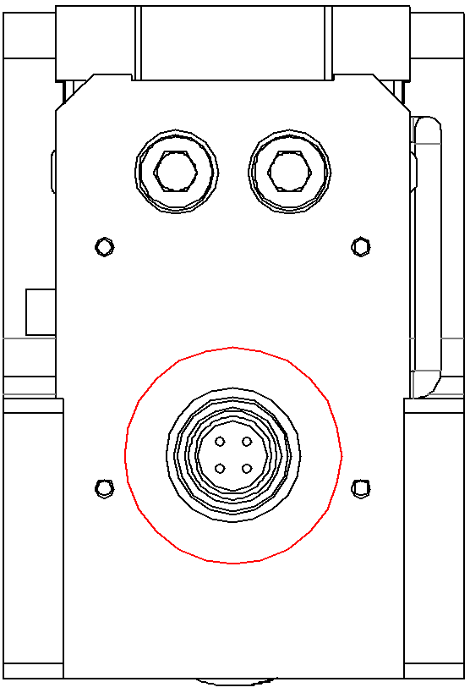
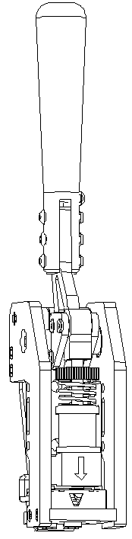
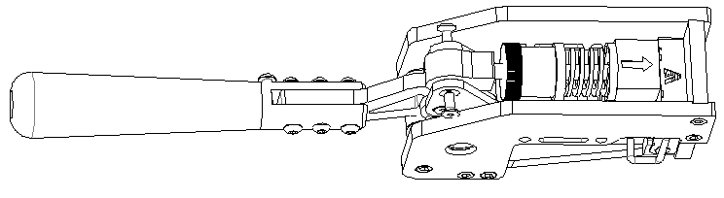
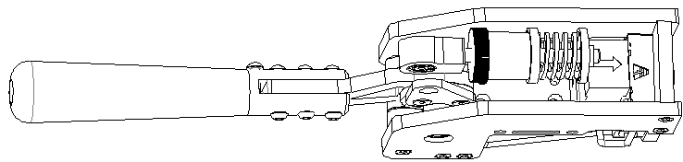
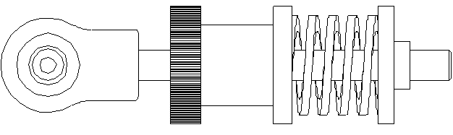
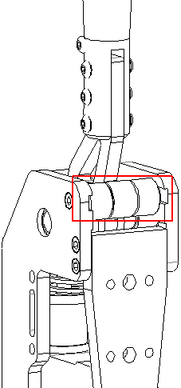

VNM HANDBRAKE
Quick Guide
Content
Connection
At the left of Handbrake is: Plug-in loadcell input by jack XH2.54-4P
At the right of Handbrake is:
1. Switch DFU/Game Mode Slide left side to select DFU Mode or right side to select Game Mode
1
4
2
5
1
3
6
At the bottom of Handbrake is: Plug-in Connect to PC by USB – GX12 cable
1. VNM Handbrake
2. Addon prokit (horizontal arm; red, blue spring & green elastomer)
3. Hexagon alley key
4. USB – GX12 cable
5. Steel springs
6. Addon Back plate for Handbrake and Shifter
Exchange Elastomer & Spring
Adjust Handbrake
Adjust Spring & elastomer:
Clockwise to made force heavier.
Counter-clockwise to made force lighter.
Remove scews
Exchange Elastomer or Spring
Adjust the angle of inclination:
Remove 2 screws left, right
Drag out adjustment part
Rorate it, it has 6 postions. Choose postion you want.
Push that adjustment part in sliding slot.
Screw up and play.
Tighten scews

Slide 2
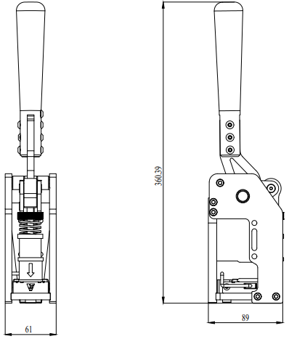
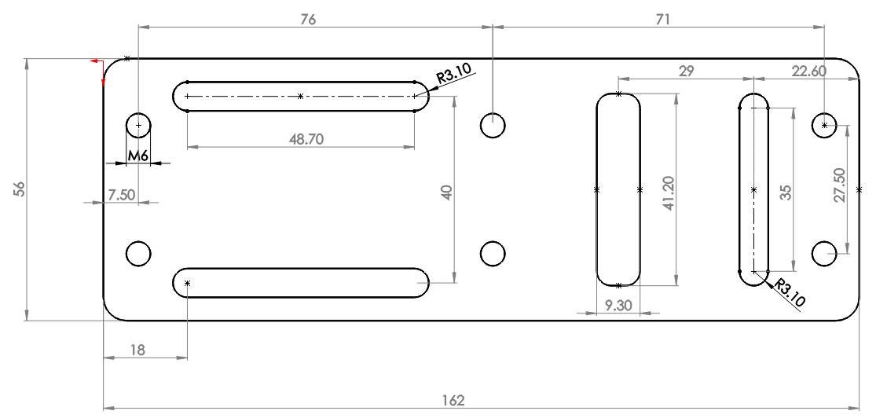
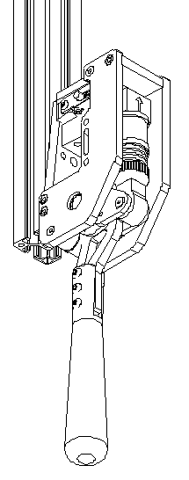
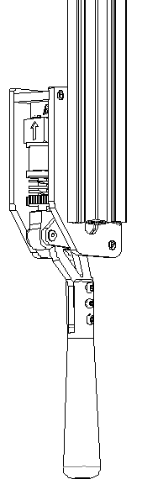
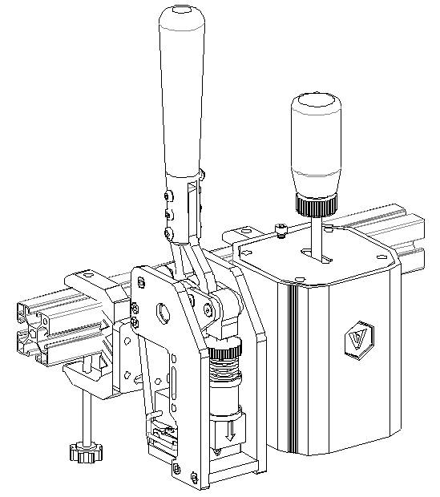
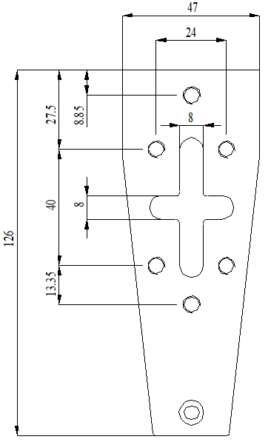
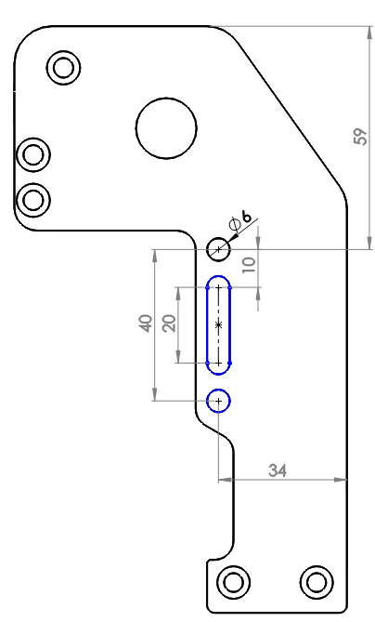
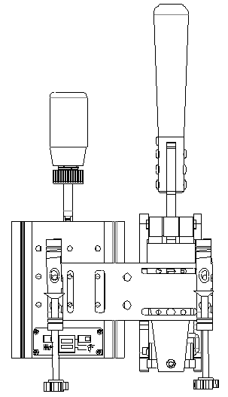
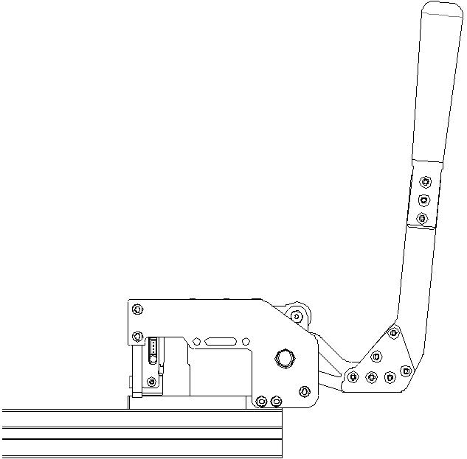
Mounting Drawing
Plate Handbrake - Shifter Drawing
Table Clamp

